Slide 1


Managing a Startup
EXE101

Slide 2
Learning Objectives
List the basic legal needs when setting up a new startup
Identify the different types of accounting methods
Discuss the differences among financial statements
Recognize income statements, balance sheets, cash flow statements, and annual report
Discuss the six business ethical theories
Make ethical decision based on the 8 steps
Identify & discuss the four key leadership theories
By the end of this lesson, you should be able to:
Knowledge: Basics of a startup’s accounting & financing & legality; Business ethical theories; Key leadership theories
Competence/Skill: Correctly identify basic legal, accounting, financing needs of a startup; Apply ethics to make sound ethical decisions when leading; Apply leadership theories in managing your startup and team
Performance: Students will recognize the basic legal, accounting, financing needs of a startup; Students will make ethical business decisions; Students will recognize their leadership theories and lead effectively

Slide 3
Legal Basics

Slide 4
Legal Basics
Company Formation & Registration: (Ziter, 2023)
Choosing a legal entity:
  Most common entity is the Limited Liability Company (LLC)
    Flexibible, simple governance structure
  Joint-stock company (JSC) is another common option
    Suitable for larger scale operations, employee stock ownership plans (“ESOPs”), public listing and accessing capital markets
Registration and licensing:
  Obtaining an enterprise registration certificate (ERC), tax registration, sector-specific licences/permits

Slide 5
Legal Basics (Cont.)
Intellectual property Protection: (Ziter, 2023)
Intellectual property or IP provides competitive advantages for startups.
Startups in Vietnam can seek copyright protection, patent protection for inventions and register trademarks for brand identity
Copyright protection is automatic upon the creation of original works

Slide 6
Legal Basics (Cont.)
Employment Law and Contracts: (Ziter, 2023)
The Labor Code provides obligations and requirements
Compliance with social insurance, labor tax obligations, employment contract regulations
Employing foreign nationals: Visa & work permits required
Labor contracts are legally binding agreement between employers and employees

Slide 7
Accounting, Financing Basics

Slide 8
Accounting, Financing Basics
Benefit of accurate accounting: (Osman, 2024)
Financial Health
  Providing clear & detailed picture of your expenses, debt, income, assets and liabilities.
Impress investors
  Easier to project growth
  Valuation of startup is simpler
Pay taxes correctly
  Accounting provides detailed income, expenses, and deductibles for tax calculations
Analytics and planning
  Accounting provides financial statements: balance sheet, cash flow statement, and income statement (profit and loss statement)

Slide 9
Accounting, Financing Basics (Cont.)
Accounting Method: (Osman, 2024)
Cash basis accounting method
  Income & expenses are accounted for as and when they happen.
  Transactions are recorded only when you spend or receive money
  Works well for small startup with cash transactions and no inventory
Accrual basis accounting method
  Transactions are recorded when they are slated
  Revenues are recorded before payments are received
  Expenses are recorded as they incurred

Slide 10
Accounting, Financing Basics (Cont.)
General ledger: (Osman, 2024)
All financial transactions go into a general ledger
Each transaction has its own corresponding journal entry
Reconciliation: (Osman, 2024)
Comparing bank statements with general ledger to ensure every bank transaction has a corresponding ledger entry
Helps detect fraud, mistakes, and data-entry errors

Slide 11
Accounting, Financing Basics (Cont.)
Financial Statements: (Stobierski, 2020)
Balance Sheet:
  Portrait the Book Value of a company
  Allow you to see what resources are available, how they were financed as a specific date
  Shows assets, liabilities and owners’ equity
  Equation: Assets = Liabilities + Owners’ Equity
    Assets: anything your company owns with quantifiable value
    Liabilities: money your company owes to a debtors
    Owners’ equity: net worth of your company

Slide 12
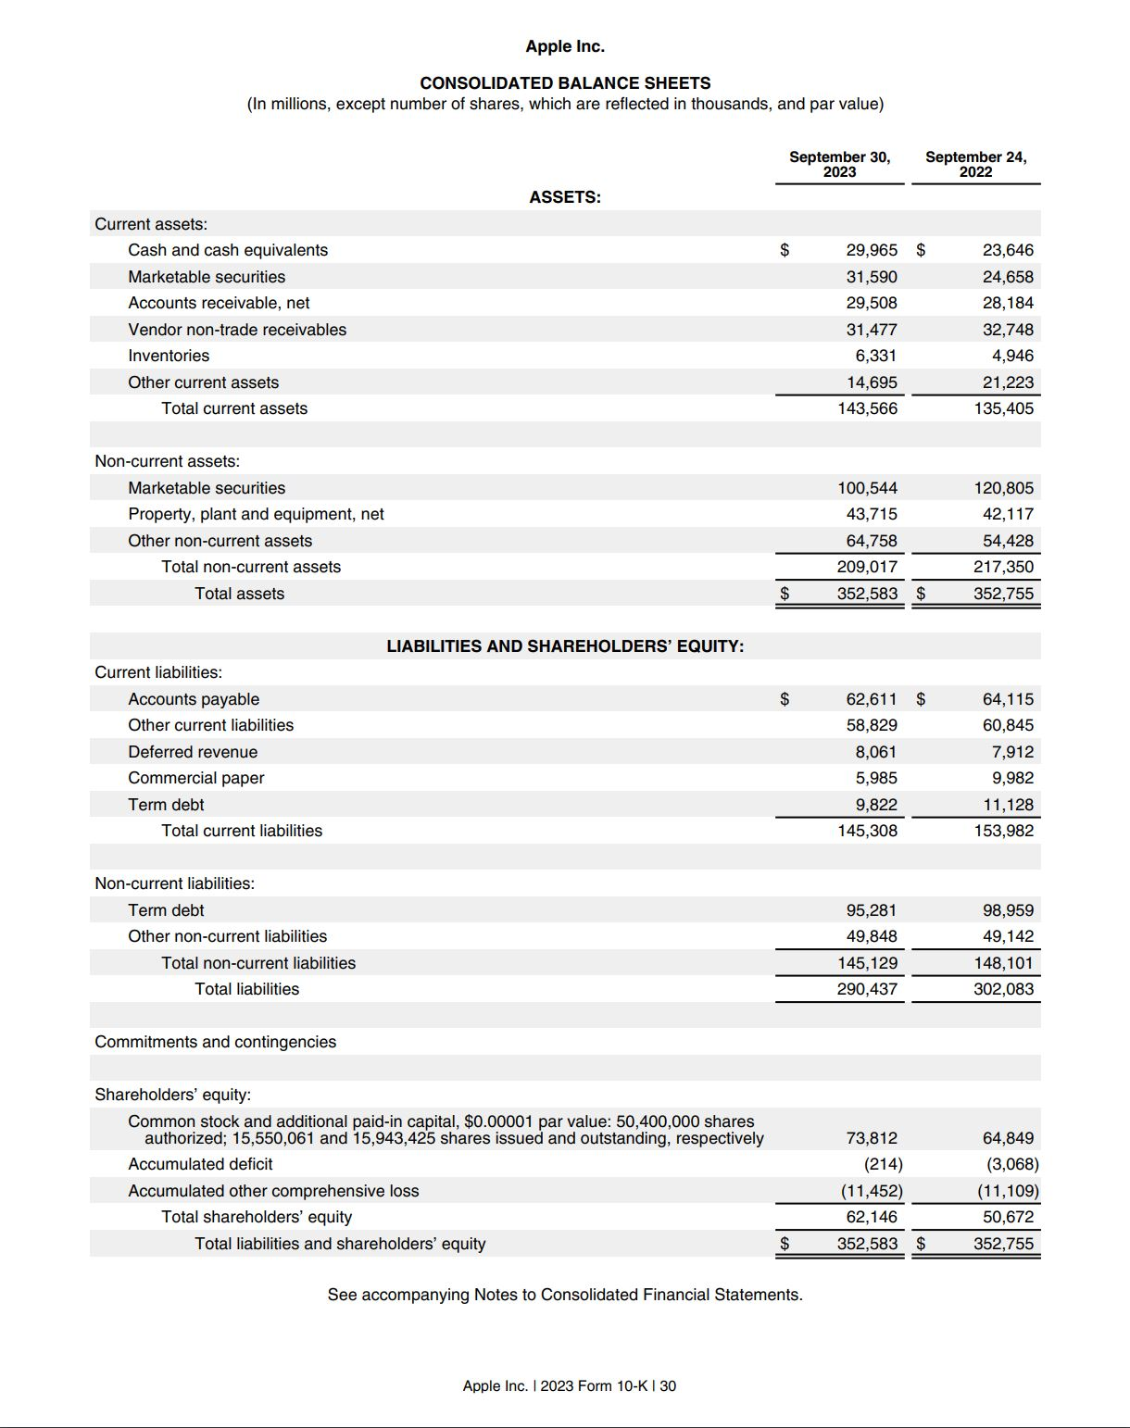
Apple’s Consolidated Balance Sheet Example

Slide 13
Accounting, Financing Basics (Cont.)
Financial Statements: (Stobierski, 2020)
Income Statement or Profit and Loss statement (P&L)
  Show how revenue, gain, expense, and loss transactions impacted for a given period
  Information includes: (Stobierski, 2020)
    Revenue: The amount of money a business takes in
    Expenses: The amount of money a business spends
    Costs of goods sold (COGS): The cost of component parts of what it takes to make whatever a business sells
    Gross profit: Total revenue less COGS
    Operating income: Gross profit less operating expenses
    Income before taxes: Operating income less non-operating expenses
    Net income: Income before taxes less taxes
    Earnings per share (EPS): Division of net income by the total number of outstanding shares
    Depreciation: The extent to which assets (for example, aging equipment) have lost value over time
    EBITDA: Earnings before interest, taxes, depreciation, and amortization

Slide 14
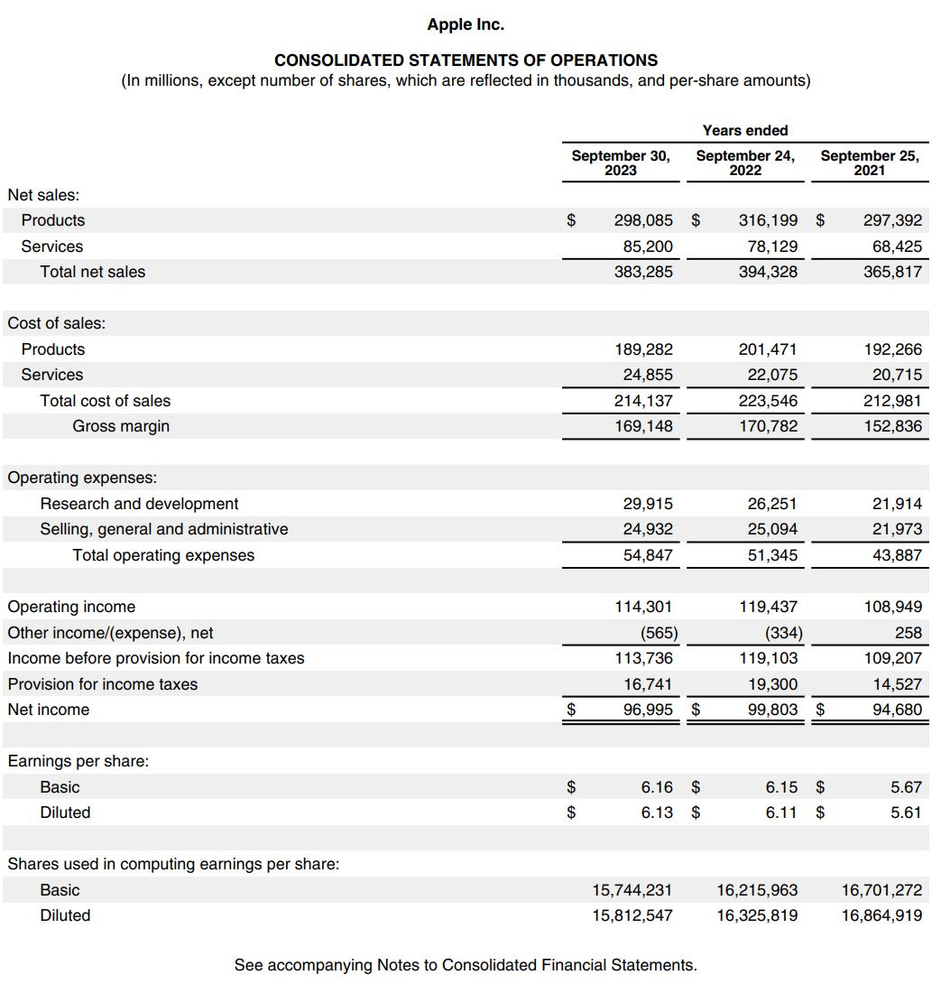
Apple Income Statement Example

Slide 15
Accounting, Financing Basics (Cont.)
Financial Statements: (Stobierski, 2020)
Cash Flow Statement
  Provide the detailed look of cash during a specific duration of time (accounting period)
  Demonstrate a company’s ability to operate in the short and long term
  Cash flow sections: Cash flow from Operating activities, Cash flow from Investing activities, and Cash flow from Financing activities
  Cash from operating income exceed net income = positive cash flow
  Positive cash flow does not mean profitability

Slide 16
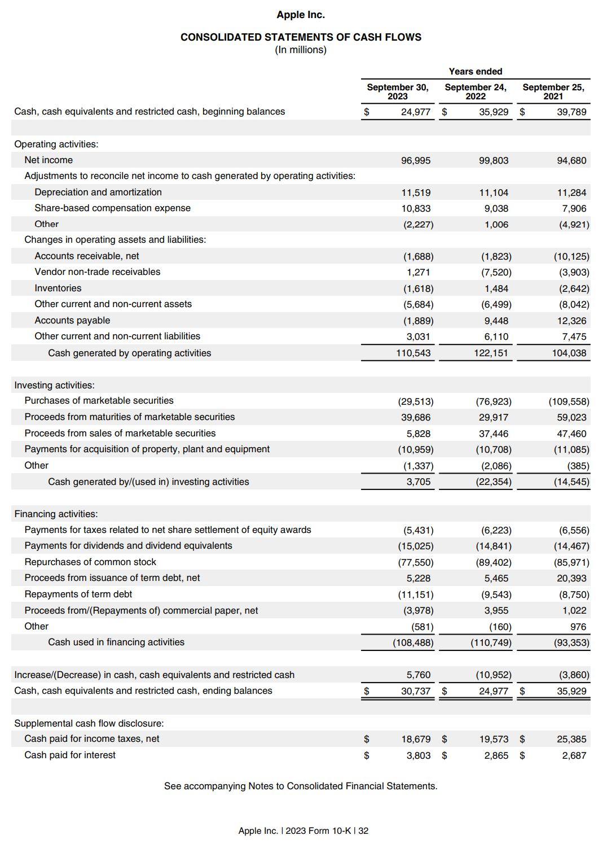
Apple’s Consolidated Statement of Cash Flows Example

Slide 17
Accounting, Financing Basics (Cont.)
Annual Report (Stobierski, 2020)
A publication that public corporations are required to publish annually to shareholders to describe their operational and financial conditions
Includes: images, infographics, letter from the CEO, corporate activities, benchmarks, achievements, summary of financial data (income statement, balance sheet, cash flow statement), industry insights, management discussion and analysis (MD&A), accounting policies, additional investor information.
Provides greater insight into the corporation’s mission and goals

Slide 18
How to Lead:
Ethical Theories
&
Ethical Decisions Making

Slide 19
Six Business Ethical Theories
Utilitarianism
Theory of Justice
Rights Theory
Integrated Social Contract Theory
Theory of Objectivism
Ethic of Care

Slide 20
Utilitarianism
Classical Utilitarians: “the greatest amount of good for the greatest number” (Driver, 2022)
Generally defined as “the morally right action is the action that produces the most good” (Driver, 2022)
Distinguished by: Impartiality and agent-neutrality. Happiness among individuals are equal. (Driver 2022)
Goal: increase “utility” or happiness (Driver, 2022)

Slide 21
Theory of Justice - John Rawl
Definition: “Rawls’s principles of justice as fairness articulate the central liberal ideas that cooperation should be fair to all citizens regarded as free and as equals.” (Wenar, 2021)
Two principles:
“Each person has the same indefeasible claim to a fully adequate scheme of equal basic liberties, which scheme is compatible with the same scheme of liberties for all;
Social and economic inequalities are to satisfy two conditions:
  They are to be attached to offices and positions open to all under conditions of fair equality of opportunity;
  They are to be to the greatest benefit of the least-advantaged members of society (the difference principle)” (Wenar, 2021)

Slide 22
Rights Theory - Robert Nozick
Definition: “Rights are entitlements (not) to perform certain actions, or (not) to be in certain states; or entitlements that others (not) perform certain actions or (not) be in certain states” (Wenar, 2023)
Rights: “Nozick says, because each person possesses an inviolability that all others must respect. ‘Individuals have rights,’ he wrote, ‘and there are things no person or group may do to them (without violating their rights)’ (Nozick 1974, ix).” (Wenar, 2023)
Positive rights = entitled to provision of some good or service
Negative rights = entitled to non-interference
Example: the right to not be robbed is a negative right while the right to a birthday cake is a positive one

Slide 23
Integrated Social Contract Theory
Generally defined as “the agreement of all individuals subject to collectively enforced social arrangements shows that those arrangements have some normative property (they are legitimate, just, obligating, etc.)” (D’Agostino et al., 2024)
Goal: “Social (moral, political, legal, etc.) rules can be rationally justified” and “Justification does not rely, for its foundation, on some exogenous reason or truth. Justification is generated endogenously by rational agreement” (D’Agostino et al., 2024)

Slide 24
Theory of Objectivism - Ayn Rand
Rand’s definition of Ethics: “is a code of values to guide man’s choices and actions—the choices and actions that determine the purpose and the course of his life. (1961b: 13)” (Badhwar and Long, 2023)
Definition: “Ethics is an objective, metaphysical necessity of man’s survival” (p. 24). Thus, [t]he standard of value of the Objectivist ethics … is man’s life, or: that which is required for man’s survival qua man, (1961b: 25) that is, the terms, methods, conditions and goals required for the survival of a rational being through the whole of his lifespan—in all those aspects of existence which are open to his choice. (1961b: 27)” (Badhwar and Long, 2023)
Ultimate goal: One’s own happiness (Badhwar and Long, 2023)

Slide 25
Ethic of Care - Feminist Ethics
Perspective of Care: “Women, in Gilligan’s studies, were as likely to express the perspective of justice as they were to express a perspective that valued intimacy, responsibility, relationships, and caring for others, while seeing autonomy as “the illusory and dangerous quest” (Gilligan 1982, 48), in tension with the values of attachment” (Norlock, 2019)
Goal: Helping the less fortunate & Relationships matter most

Slide 26
8 Steps to Sound Ethical Decisions Making
Given you have chosen ONE ethical theory to apply,
Gather the facts
Define the ethical issues
Identify the affected parties
Identify the consequences
Identify the obligations
Consider your character and integrity
Think creatively about potential actions
Check your gut

Slide 27
How to Lead:
Leadership Theories

Slide 28
Key Leadership Theories
Trait Theory
According to Thomas Carlyle, “all great achievements can be attributed to the work of heroes, or ‘great men,’” (Shonk, 2024)
Only certain extraordinary individuals possessed the traits required for effective leadership. Others could not develop such traits (Shonk, 2024)
Contingency Theory
Theorized that “earlier management theories had neglected the influence of situational factors, or contingencies, on organizations” (Shonk, 2024)
Task Oriented Leadership:
Focus on tasks completion
Autocratic, authoritarian, directive
Relationship Oriented Leadership:
Focus on building relationships
Prioritize healthy work culture

Slide 29
Key Leadership Theories (Cont.)
Participative Leadership Theory
A democratic leadership style with subordinates are intentionally involved in organizational decision making (Shonk, 2023)
Goals:
Enhancing sense of work ownership
Improve decision making
Integrating workers’ personal goals with the organizational goals (Shonk, 2023)
Charismatic Leadership Theory
Robert House describes leaders who “by force of their personal abilities are capable of having profound and extraordinary effects on followers.” (Shonk, 2023)
Charismatic leaders tends to: Break the established order and achieve major social change (Shonk, 2023)
Charismatic leaders can behave: overconfidence; eccentricity; and attention-seeking, manipulative behavior (Shonk, 2023)

Slide 30
Key Takeaways
Legal: new startup need to choosing proper legal identity and file proper registration and licensing; be mindful of intellectual property protection and adhere to employment law & contracts
Accounting & financing: Understand the essential elements of financial statements and be able to read the Annual Report of a public company
How to lead: Understand the ethical theories, be able to choose 1 theory and apply them to your daily moral decisions; understand leadership theory and apply in managing your team

Slide 31
References
Driver, Julia, (2022) "The History of Utilitarianism", The Stanford Encyclopedia of Philosophy (Winter 2022 Edition), Edward N. Zalta & Uri Nodelman (eds.), Available at <https://plato.stanford.edu/archives/win2022/entries/utilitarianism-history/>.
Wenar, Leif, (2021) "John Rawls", The Stanford Encyclopedia of Philosophy (Summer 2021 Edition), Edward N. Zalta (ed.), Available at <https://plato.stanford.edu/archives/sum2021/entries/rawls/>.
Wenar, Leif, (2023) "Rights", The Stanford Encyclopedia of Philosophy (Spring 2023 Edition), Edward N. Zalta & Uri Nodelman (eds.), Available at <https://plato.stanford.edu/archives/spr2023/entries/rights/>.
D’Agostino, Fred, Gerald Gaus, and John Thrasher, (2024) "Contemporary Approaches to the Social Contract", The Stanford Encyclopedia of Philosophy (Spring 2024 Edition), Edward N. Zalta & Uri Nodelman (eds.), Available at <https://plato.stanford.edu/archives/spr2024/entries/contractarianism-contemporary/>.
Badhwar, Neera K. and Roderick T. Long, (2023) "Ayn Rand", The Stanford Encyclopedia of Philosophy (Winter 2023 Edition), Edward N. Zalta & Uri Nodelman (eds.), Available at <https://plato.stanford.edu/archives/win2023/entries/ayn-rand/>.
Norlock, Kathryn, (2019) "Feminist Ethics", The Stanford Encyclopedia of Philosophy (Summer 2019 Edition), Edward N. Zalta (ed.), Available at <https://plato.stanford.edu/archives/sum2019/entries/feminism-ethics/>.
Ziter, Philip, (2023) “Formation To Funding: Legal Considerations for Tech Startups in Vietnam”, Russin & Vecchi, Available at <https://www.russinvecchi.com.vn/publication/formation-to-funding-legal-considerations-for-tech-startups-in-vietnam/>
Osman, Maddy, (2024) “How To Do Accounting for Your Startup: Steps, Tips, and Tools”, Hubspot, Available at <https://blog.hubspot.com/sales/accounting-for-startups>
Stobierski, Tim, (2020) “THE BEGINNER’S GUIDE TO READING & UNDERSTANDING FINANCIAL STATEMENTS”, Harvard Business Review, Available at <https://online.hbs.edu/blog/post/how-to-read-financial-statements>
Shonk, Katie, (2023) “Charismatic Leadership: Weighing the Pros and Cons”, Program on Negotiation Harvard Law School, Available at <https://www.pon.harvard.edu/daily/leadership-skills-daily/charismatic-leadership-weighing-the-pros-and-cons/>
Shonk, Katie, (2023) “Participative Leadership: What It Can Do for Organizations”, Program on Negotiation Harvard Law School, Available at <https://www.pon.harvard.edu/daily/leadership-skills-daily/participative-leadership-what-it-can-do-for-organizations/>
Shonk, Katie, (2024) “The Contingency Theory of Leadership: A Focus on Fit”, Program on Negotiation Harvard Law School, Available at <https://www.pon.harvard.edu/daily/leadership-skills-daily/the-contingency-theory-of-leadership-a-focus-on-fit/>
Shonk, Katie, (2024) “The Trait Theory of Leadership”, Program on Negotiation Harvard Law School, Available at <https://www.pon.harvard.edu/daily/leadership-skills-daily/the-trait-theory-of-leadership/>

